Slide 1
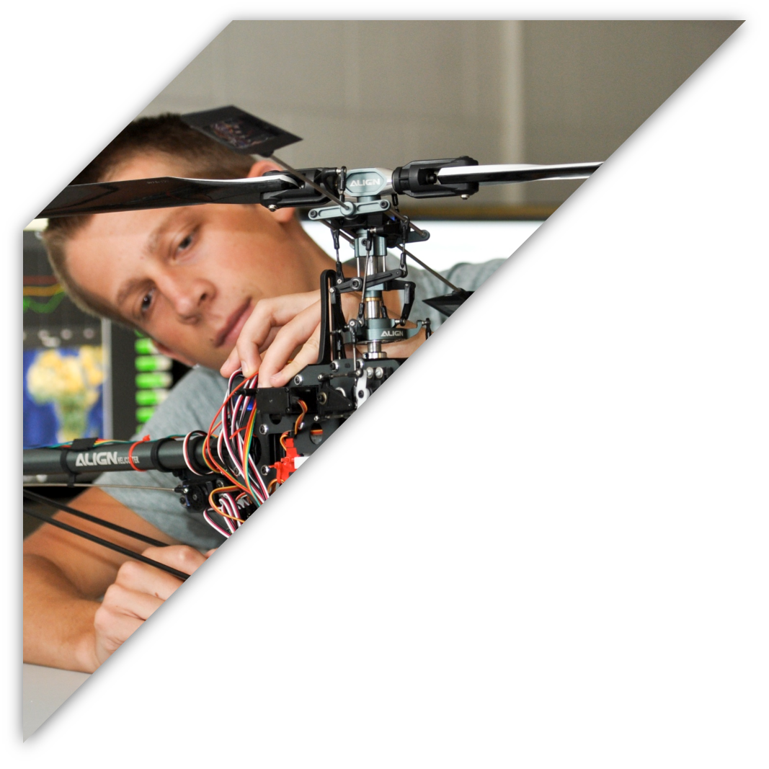

ECEN 403
GAN Assisted Map Reconstruction for first responders using Sensor Fusion:
Christian Jeardoe, Quinn LeBoeuf
Kyle Smejkal, Rufus Tadpatri

Slide 2

Executive Summary
Problem Statement:
Emergency situations often require first responders to delve into dangerous environments with minimal information.
Fires, gas leaks, atmospheric hypoxia, and radioactivity are examples of hazards in various environments
Our GAN model will:
Receive various sensor data which include:
-ultrasonic -infrared -RGB -kinect
Develop 3D point clouds from individual sensor data which will be fused for 3D environment model development

Slide 3
System Overview
Generative Adversarial Network (GAN) Model
A GAN is a specific type of machine learning model where in two neural networks will compete with each other in a zero-sum game framework to become more accurate in their task.
Generator
The neural network responsible for creating new data based on the training data set, with the goal of convincing the discriminator it is “real” data.
Discriminator
The neural network responsible for determining if the data it is receiving is “real” data or artificially created data by the generator.

Slide 4
Kinect (RGB/IR Depth) Sensor Subsystem
Microsoft Kinect
The Kinect sensor is made up of both an RGB sensor and IR projector/depth sensor
GAN model reconstruction and upscaling
The GAN model for this specific sensor will focus on reconstructing low quality/missing sensor inputs and upscaling the resulting point cloud

Slide 5
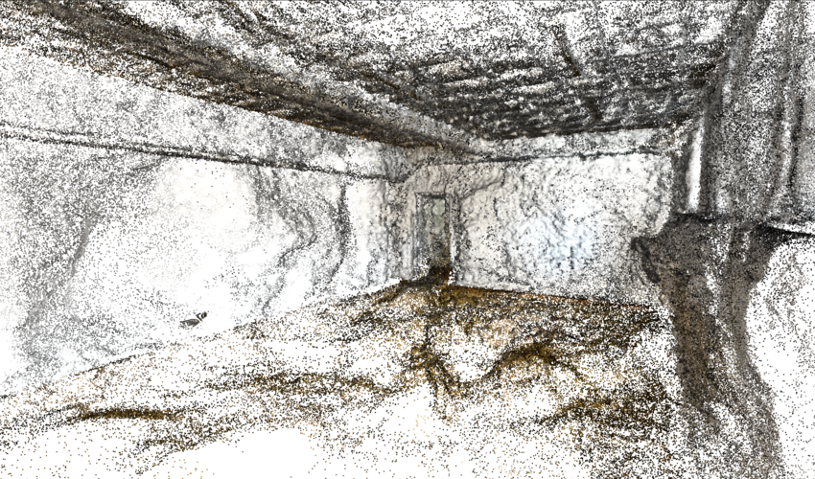
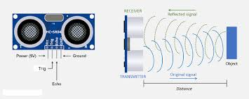
Ultrasonic Sensor Subsystem
Ultrasonic Sensor Data Collection and Controller
Rapid data retrieval and concurrent GAN processing
GAN Model for 3D Cloud Point Generation from Sensor Data
Distance measurements are used to create accurate base dimensions for an enclosed space
Challenges:
Object vs. Wall/Surface Identification
https://www.researchgate.net/figure/Point-cloud-of-the-3D-model-of-the-empty-room-seen-from-a-corner-of-the-room_fig10_381531950
https://osoyoo.com/2018/09/18/micro-bit-lesson-using-the-ultrasonic-module/

Slide 6
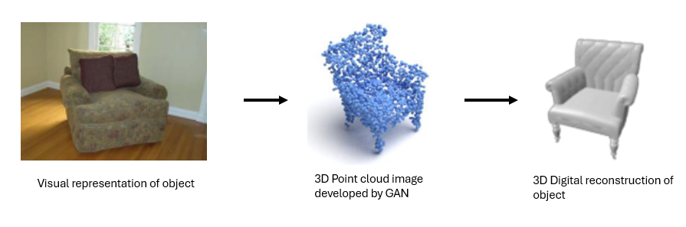
RGB Sensor Subsystem
RGB Camera
Camera will plug directly into laptop
Model will run using data in realtime
GAN Model Generation
RGB Data will be preprocessed through the model to convert images into point clouds
Image from: https://weiyao1996.github.io/files/publications/BMVC_2022.pdf

Slide 7
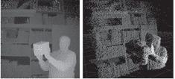
Infrared Sensor Subsystem
Infrared Sensor
Thermal imaging and depth information
Sensor will connect to computer through arduino microcontroller
GAN Model
Runs on external computer using IR images to create a 3D point cloud of environment

Slide 8
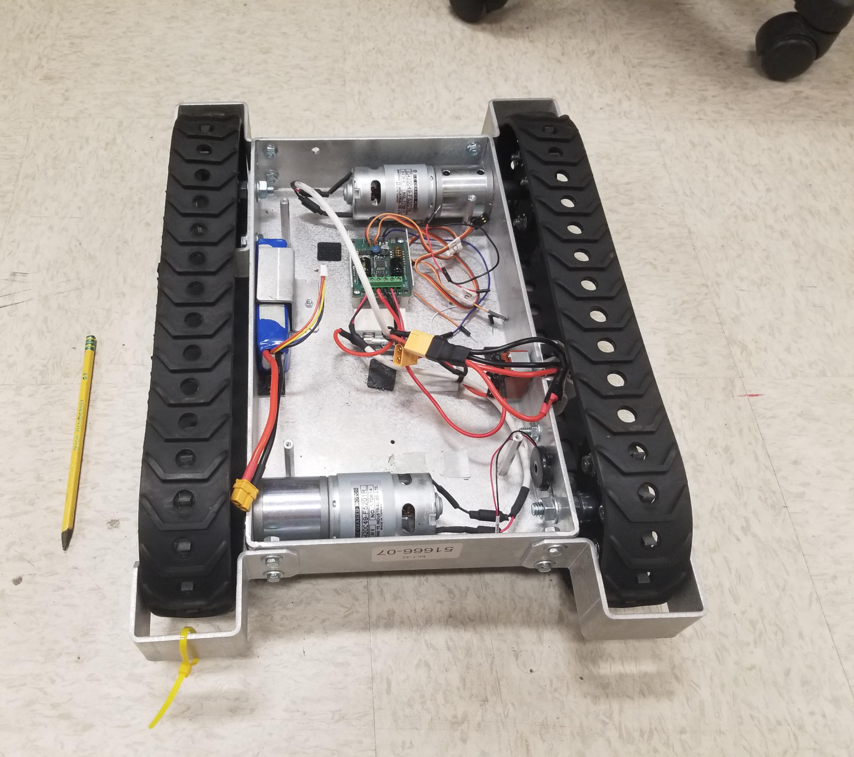
Project Integration
- Deliverable: Four trained GAN models that convert data into a 3D point clouds
-All four point clouds will be integrated together into a unified 3D digital-twin
-The robot will have all four sensors mounted to it and will have the ability to output an identical image regardless of the sensor being used

Slide 9
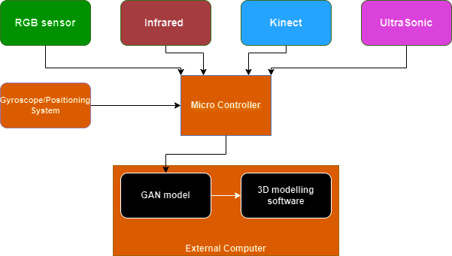
Project Integration

Slide 10
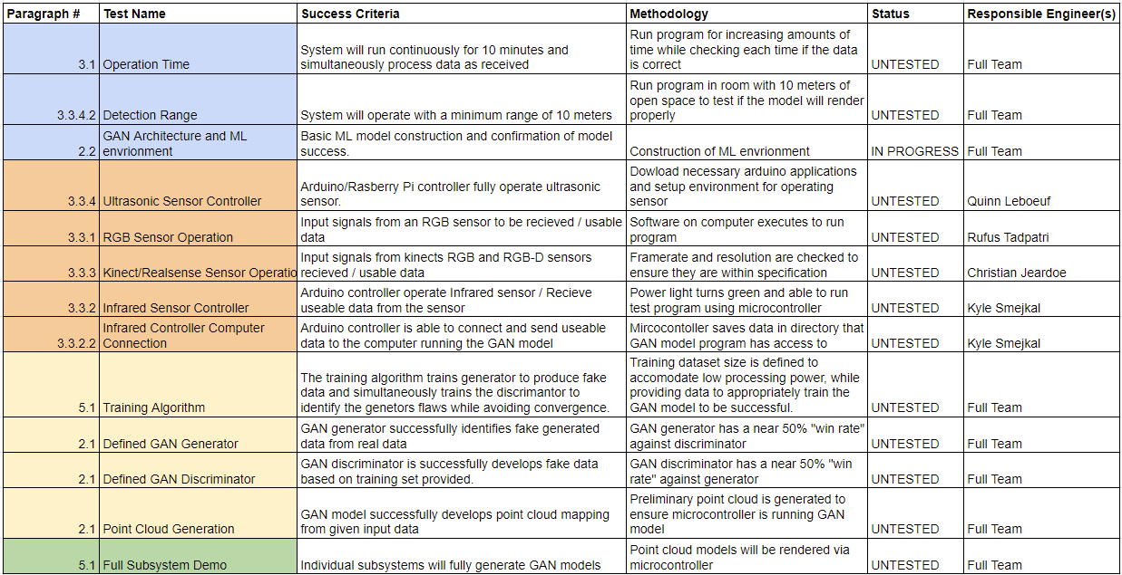
Execution and Validation

Slide 11
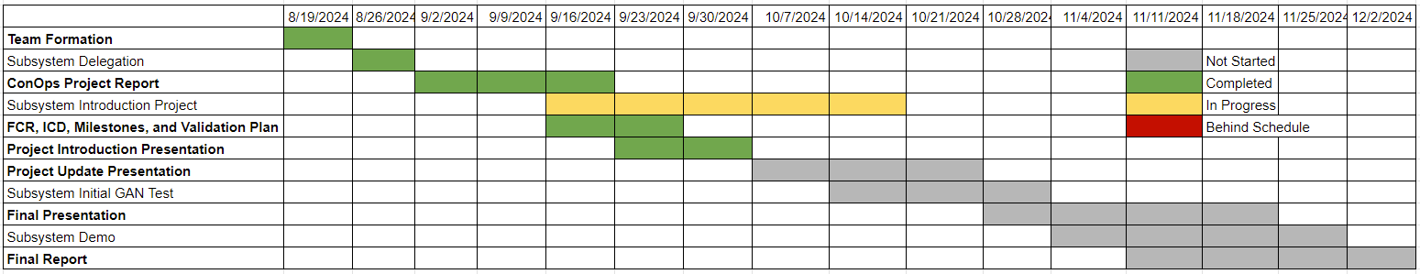
Project Timeline

Slide 12
Thank you

